Slide 1
SCALE SPACE BLOB DETECTION
Mini Project [2]

Slide 2
Submitted by
Eslam Hussein Mohamed.
Nadine Ashraf Adeeb.
Tasneem Yassin Mostafa.
Supervised by:
Dr: Mahmoud Atef.
TA: Abdelrahman Nady.

Slide 3
introduction
The goal of the project is to implement a Laplacian Blob Detector.
Blob detection methods are aimed at detecting regions in a digital image that differ in properties, such as brightness or color, compared to surrounding regions.
we applied Scale-space blob detection using two approaches:
Laplacian of Gaussian scale space.
Enhanced Laplacian of Gaussian scale space.
In The following we will discuses each algorithm and show the results.

Slide 4
Algorithms
Scale-space blob detection
Start
Read The input Image
Build a scale space
RGB Into Grayscale
Nonmaximum suppression in scale space
Convert Into Double
Thresholding
Display resulting circles
End

Slide 5
Laplacian of Gaussian scale space

Slide 6
Algorithms
Laplacian of Gaussian scale space
Read the input image into a matrix.
Convert the RGB image into grayscale one.
Convert the image type into double data type to perform your mathematical operation.
Convolute the image with different scales of Laplacian gaussian filter to build the scale space image which has the image features.
Apply Non-maximum suppression on the scale space image.
Threshold the scale space image to get the desired local features.
Detriment the co-ordinates of each feature and its value.
Display resulting circles at their characteristic scales

Slide 7
LOG Sigma-0
Sigma-0
LOG Sigma-1
Sigma-1
Sigma-k
Sigma-k
Sigma-k
Sigma-k
LOG Sigma-2
Sigma-2
Sigma-k
Sigma-k
Sigma-k
Sigma-k
Sigma-k
Original image
Sigma-k
LOG Sigma-3
Sigma-3
Sigma-k
Convolution with
Sigma-k
Sigma-k
Sigma-k
Sigma-k
Sigma-k
Sigma-k
Sigma-k
Laplacian of Gaussian scale space
LOG Sigma-k
Sigma-k

Slide 8
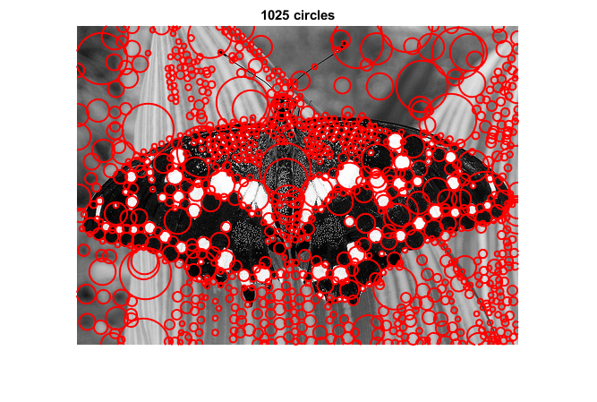
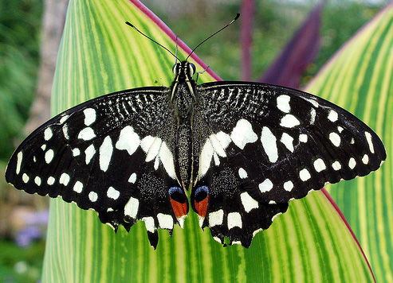
Results
butterfly.jpg
Elapsed time is 1.670132 seconds.

Slide 9
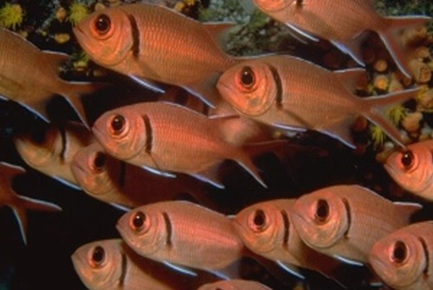
Results
fishes.jpg
Elapsed time is 0.724908 seconds.

Slide 10
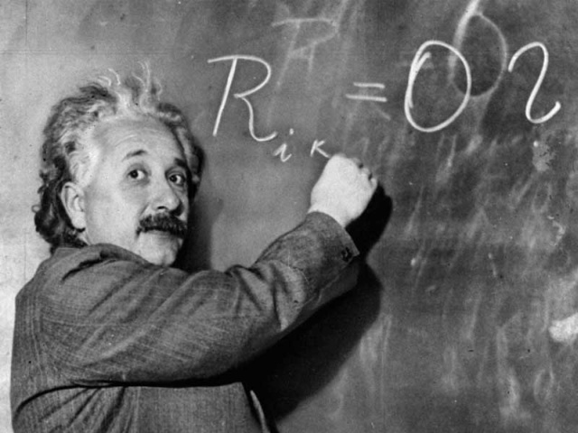
Results
einstein.jpg
Elapsed time is 0.820888 seconds.

Slide 11
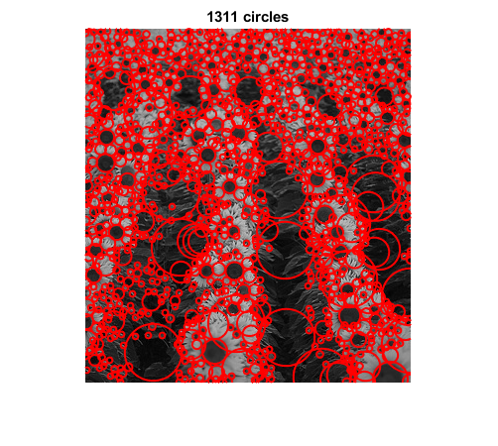
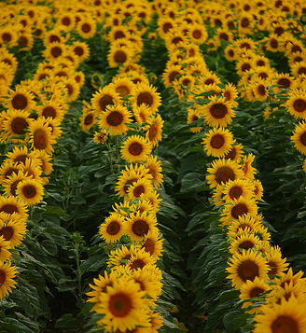
Results
sunflowers.jpg
Elapsed time is 0.326499 seconds.

Slide 12
Enhanced Laplacian of Gaussian scale space.

Slide 13
Algorithms
Enhanced Laplacian of Gaussian scale space.
Read the input image into a matrix.
Convert the RGB image into grayscale one.
Convert the image type into double data type to perform your mathematical operation.
Down scale the image by factor 1/K for several times and each time calculate the Laplacian of gaussian using a the same sigma for all times to build the scale space image which has the image features..
Upscale the scaled down image to the original image scale then apply Non-maximum suppression on the scale space image.
Threshold the scale space image to get the desired local features.
Detriment the co-ordinates of each feature and its value.
Display resulting circles at their characteristic scales

Slide 14
Original image
IMG-0
IMG-1
Sigma-k
Sigma-k
Sigma-k
Sigma-k
IMG-2
Sigma-k
Original image
Sigma-k
Sigma-k
Sigma-k
Sigma-k
LOG Sigma
IMG-3
Sigma-k
Sigma-k
Convolution with
UP Scale
Sigma-k
Sigma-k
Original image
Sigma-k
Sigma-k
Sigma-k
Sigma-k
IMG-k
Original image
Laplacian of Gaussian scale space
Original image
IMG-k
Original image
Down sampling

Slide 15
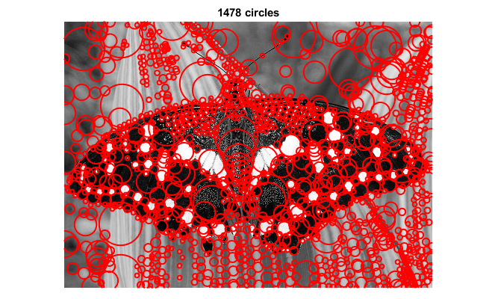
Results
butterfly.jpg
Elapsed time is 0.260910 seconds.

Slide 16
Results
fishes.jpg
Elapsed time is 0.153924 seconds.

Slide 17
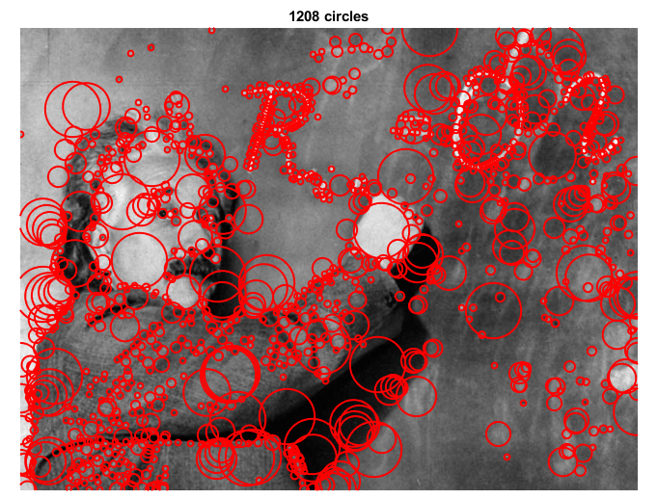
Results
einstein.jpg
Elapsed time is 0.266463 seconds.

Slide 18
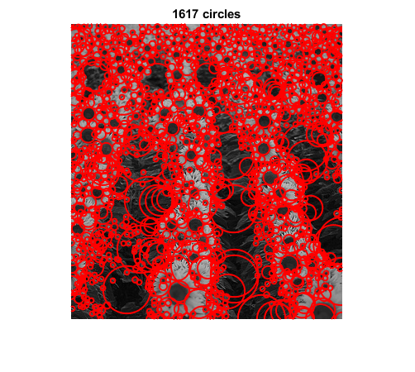
Results
sunflowers.jpg
Elapsed time is 0.110036 seconds.

Slide 19
Thank you

